Slide 1


ScamGuard AI “Fake Investment Scam & Ponzi Scheme Detection”
Aldel Education Trust’s
St. John College of Engineering and Management, Palghar
An Autonomous Institution | NAAC Accredited with Grade A+ | NBA Accredited
DEPARTMENT OF ARTIFICIAL INTELLIGENCE AND MACHINE LEARNING
Gagan Shetty [EU1226019]
Tanmay Patil [EU1226021]
Kishan Ravat [EU1226022]
Tirth Shah [EU1226009]
Dr. Juily Tarade | Assistant Professor

Slide 2
Contents
Introduction
Motivation
Problem Statement
Objectives
Scope
Review of Existing Literature
Proposed System
Block diagram of Proposed System
Technologies Used
Implementation
Conclusion and Future Work

Slide 3
Introduction
The proposed system, ScamGuard AI, aims to detect fake investment scams and Ponzi schemes on social media by analyzing text messages using Natural Language Processing and Machine Learning. The system automates the process of identifying fraudulent investment promotions and provides real-time predictions with probability scores and risk levels.
This project proposes a dual-engine AI-based scam detection system that combines TF-IDF keyword analysis with FinBERT transformer embeddings to classify messages as Legitimate or Scam. It helps users and organizations identify financial fraud early and prevent monetary losses.

Slide 4
Introduction
Motivation
The rapid growth of digital finance, cryptocurrency trading, and social media platforms has significantly increased the risk of investment scams and Ponzi schemes. Cybercriminals use platforms like WhatsApp, Telegram, and Twitter to promote fake investment offers with "guaranteed returns" targeting young and inexperienced investors.
With the advancement of machine learning and NLP techniques, it is now possible to analyze text patterns and automatically identify suspicious financial messages. Transformer models like FinBERT can understand financial language context, making scam detection more accurate than traditional keyword-based approaches.

Slide 5
Introduction
Problem Statement
To design and develop an AI-based system that can automatically detect and classify social media messages as Legitimate financial discussions or Scam/Ponzi scheme promotions using a dual-engine machine learning pipeline combining TF-IDF and FinBERT features.

Slide 6
Introduction
Objectives
To develop an automated scam detection system using machine learning and Natural Language Processing techniques.
To analyze social media messages and financial text data to identify patterns related to investment scams and Ponzi schemes.
To improve the accuracy and efficiency of fraud detection compared to traditional rule-based systems by using a dual-engine pipeline combining TF-IDF and FinBERT.
To provide an explainable and reliable system that helps users detect and prevent online financial scams using LIME-based word-level indicators.

Slide 7
Introduction
Scope
This project focuses on detecting fake investment scams and Ponzi schemes by analyzing social media text messages using machine learning algorithms and transformer-based NLP models.
The system can help reduce financial risks by identifying suspicious investment promotions and alerting users about potential fraud. It improves efficiency by automating the detection process and minimizing human intervention.
The proposed system can be applied in multiple domains such as social media platforms, messaging applications like WhatsApp and Telegram, cryptocurrency exchanges, and cybersecurity monitoring applications.

Slide 8
Review of Existing Literature
Sr. No. | Paper Title | Author & Year | Technique Used | Limitation
1 | FinBERT: Financial Sentiment Analysis with Pre-trained Language Models | Araci, 2019 | BERT fine-tuned on financial text for sentiment classification | Focuses only on sentiment, not on scam or fraud detection
2 | SMS Spam Collection: A Public Dataset for SMS Spam Research | Almeida et al., 2011 | Naive Bayes and SVM for spam classification on SMS data | Limited to generic SMS spam, no financial domain specificity
3 | "Why Should I Trust You?" — Explaining the Predictions of Any Classifier (LIME) | Ribeiro et al., 2016 | Local Interpretable Model-agnostic Explanations for any ML model | Explanations are local and may not capture global model behavior
4 | XGBoost: A Scalable Tree Boosting System | Chen & Guestrin, 2016 | Gradient boosting with GPU acceleration for classification tasks | Requires careful hyperparameter tuning and may overfit on small datasets
5 | Detecting Financial Fraud Using Machine Learning Techniques: A Survey | West & Bhattacharya, 2016 | Survey of ML methods for fraud detection in finance | Most methods use structured tabular data, not NLP on social media text
8

Slide 9
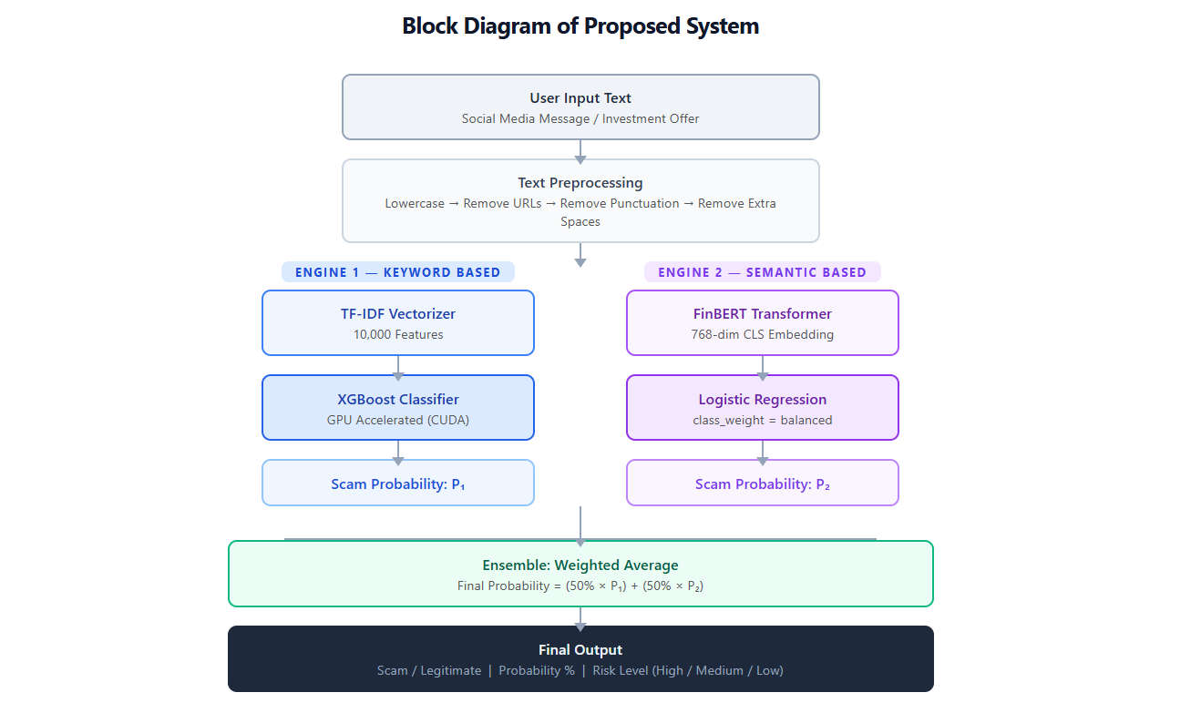
Proposed System
Fig. 1: Block diagram of the proposed system
9

Slide 10
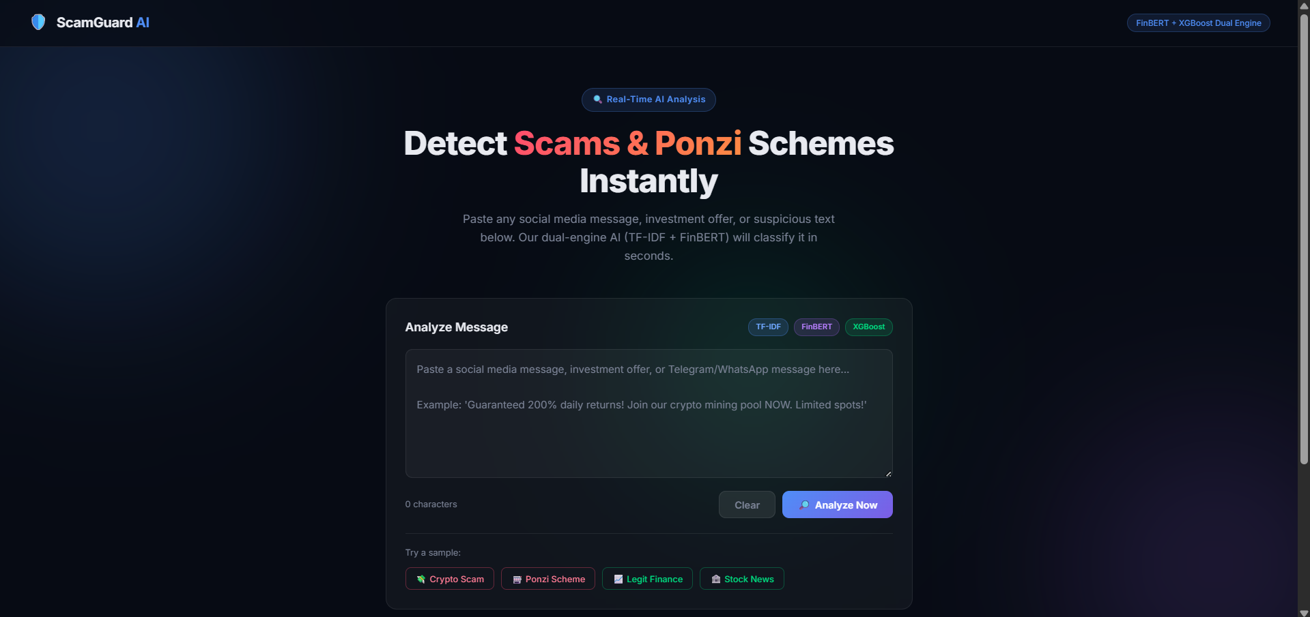
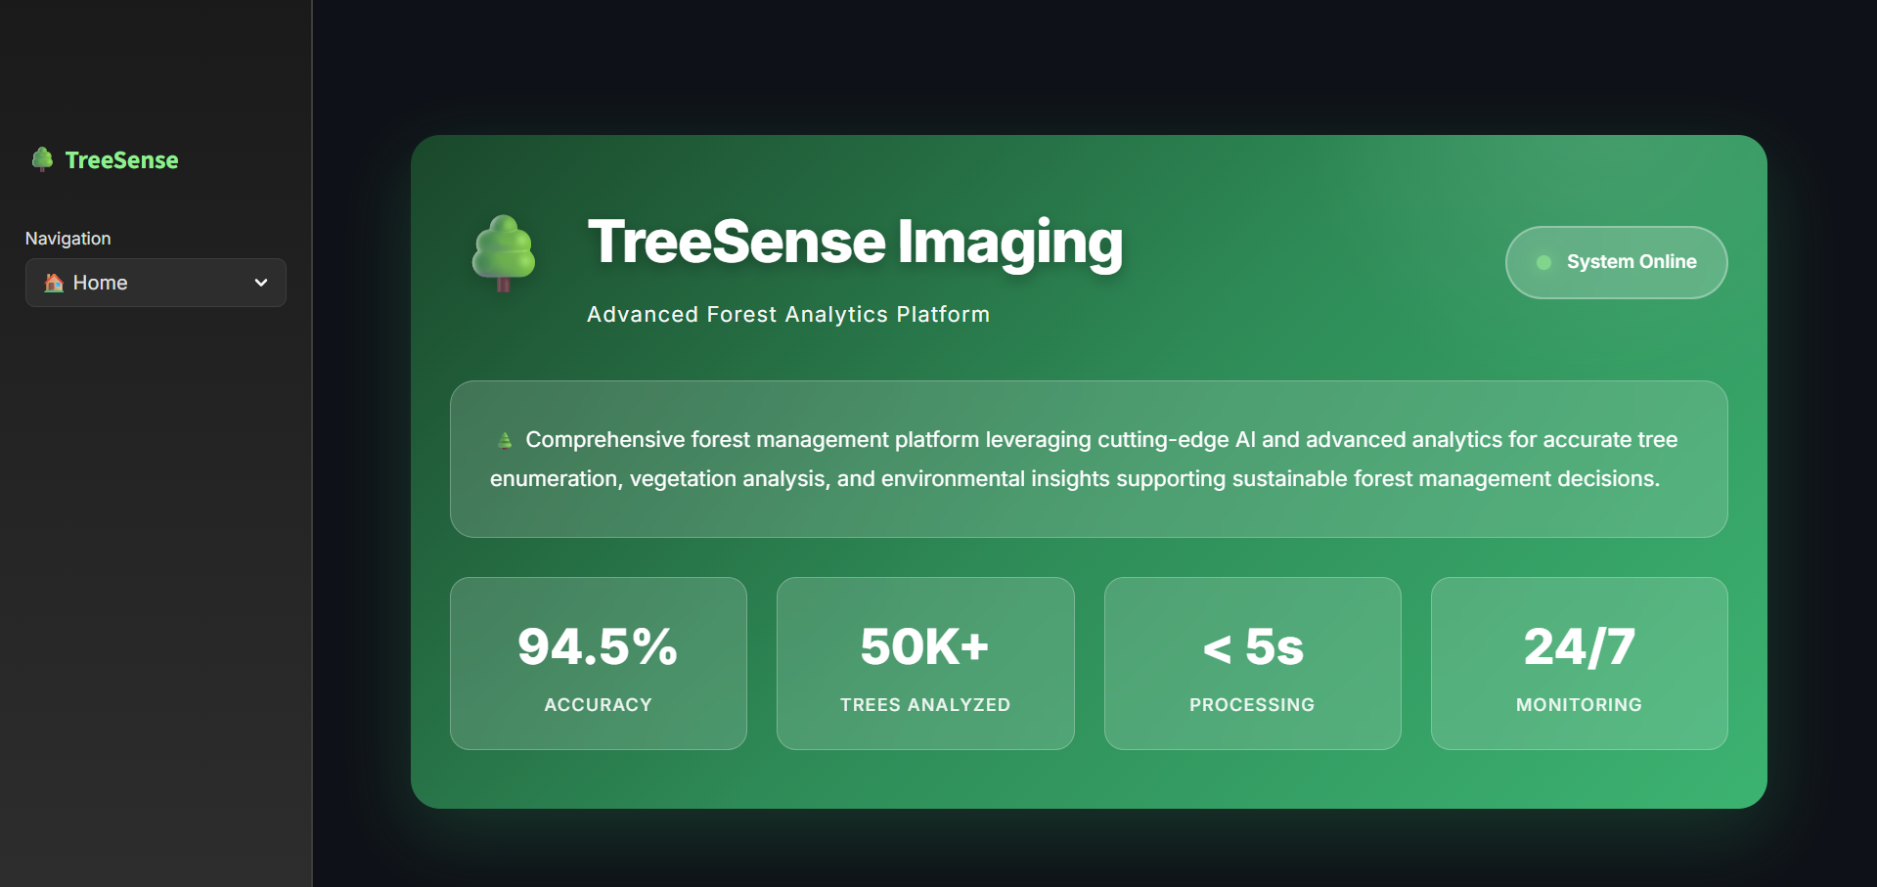
Implementation
Screenshots of the Output
Fig. 2: ScamGuard AI — Web Interface (Home Page)
10

Slide 11
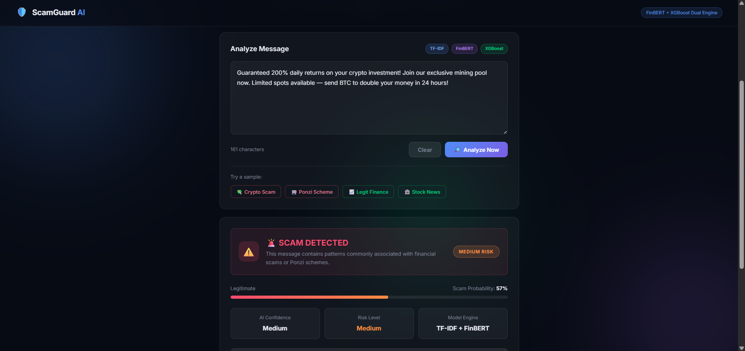
Implementation
Screenshots of the Output
Fig. 3: Scam Message Detected — Medium Risk (57% Probability).
11

Slide 12
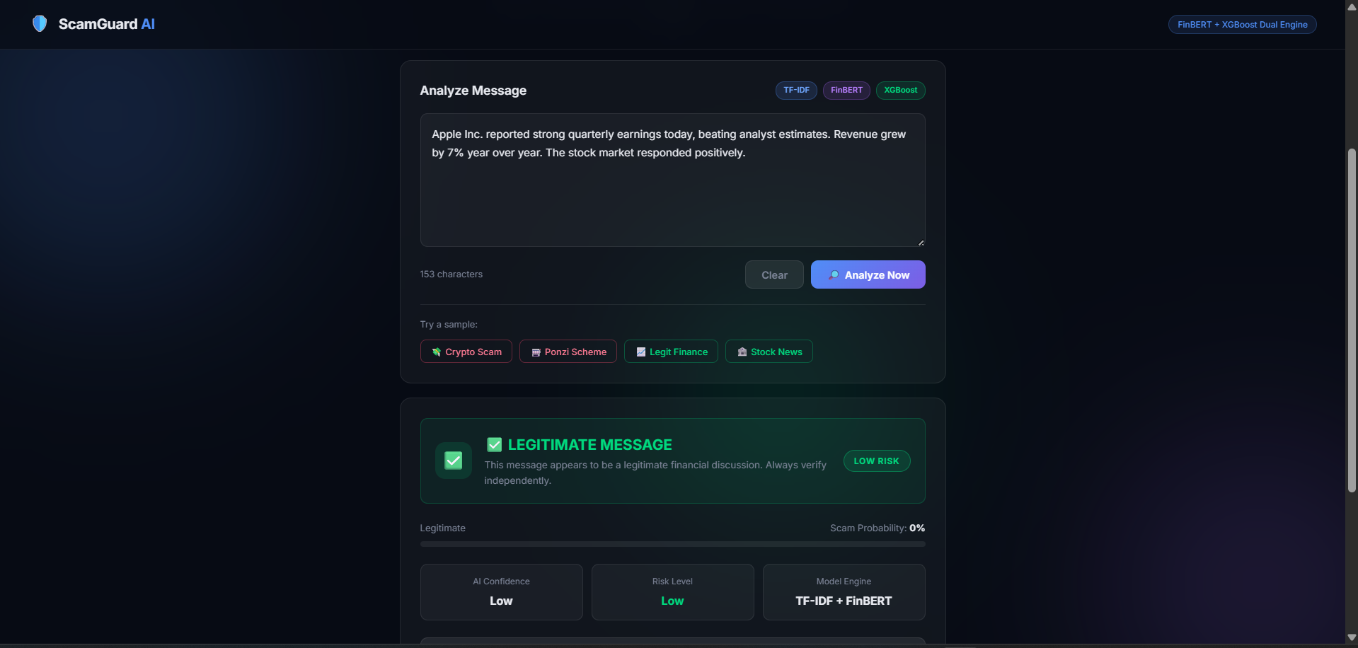
Implementation
Screenshots of the Output
Fig. 4: Legitimate Message Verified — Low Risk
12

Slide 13
Technologies Used
Frontend
HTML5, CSS3, JavaScript: Web interface
Dark-mode responsive UI design
Backend
Python: Primary language for all modules
FastAPI + Uvicorn: REST API server
Machine Learning Models
Logistic Regression
XGBoost (GPU Accelerated)
Naive Bayes
Voting Classifier
NLP & Feature Extraction
TF-IDF Vectorizer (Scikit-learn)
FinBERT Transformer (HuggingFace)
Explainability
LIME: Word-level prediction explanation
Libraries
Pandas, NumPy, Scikit-learn, Joblib, Torch, Transformers
13

Slide 14
Conclusion and Future Work
Conclusion
Successfully built a dual-engine AI system for detecting investment scams and Ponzi schemes on social media using FinBERT and TF-IDF.
Future Work
Fine-tune FinBERT – Train FinBERT specifically on real investment scam data for better accuracy
Better Dataset – Collect real crypto scam posts from Reddit, FTC complaints, and Telegram groups
Browser Extension – Build a Chrome extension to scan web pages and messages in real-time
URL Analysis – Add URL reputation checking alongside text-based scam detection
Multi-language Support – Extend detection to Hindi, Marathi, and other regional languages
14

Slide 15
Thank You !!!
15

Slide 16
Q & A
16

